Slide 1
CIRCLES

Slide 2
SPECIFIC OBJECTIVES:
At the end of the lesson, the student is expected to be able to:
• draw a circle given different points.
• determine center and radius of the circle given an equation.
• determine general and standard form of equation of the circle given some geometric conditions.
• convert general form to standard form of equation of the circle and vice versa.

Slide 3
CIRCLE
A circle is a locus of points that moves in a plane at a constant distance from a fixed point. The fixed point is called the center and the distance from the center to any point on the circle is called the radius.
Parts of a Circle
Center - It is in the centre of the circle and the distance from this point to any other point on the circumference is the same.
Radius - The distance from the centre to any point on the circle is called the radius. A diameter is twice the distance of a radius.
Circumference - The distance around a circle is its circumference. It is also the perimeter of the circle

Slide 4
Chord - A chord is a straight line joining two points on the circumference. The longest chord in a called a diameter. The diameter passed through the centre.
Segment - A segment of a circle is the region enclosed by a chord and an arc of the circle.
Secant - A secant is a straight line cutting at two distinct points.
Tangent - If a straight line and a circle have only one point of contact, then that line is called a tangent. A tangent is always perpendicular to the radius drawn to the point of contact.

Slide 5
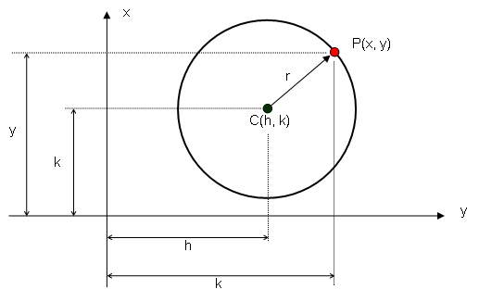
Equation of a Circle

Slide 6
I. Sketch the graph of the circle whose equation is x² + y² – 3x + 5y – 14 = 0.
II. Find the equation of the circle which satisfies the ffg. conditions:
w/c has for the diameter the segment joining the points (5, -1) and (-3, 7).
w/c is passing through the origin, r=13 and the abscissa of its center is -12.
w/ C(-4, 2) and is tangent to the line 2x – y + 2 = 0.
w/c is tangent to both axes and has its center on the line 2x + y = 4.

Slide 7
5. which passes through the points (-3, 6), (-5, 2) and (3, -6).
w/c is inscribed in a triangle determine by the lines L₁: y = 0, L₂: 3x – 4y + 30 = 0 and L₃: 4x + 3y = 60.
w/c is circumscribing a triangle determine by the lines x + y = 8, 2x + y = 14, 3x + y = 22.

Slide 9


Let:
C (h, k) - coordinates of the center of the circle
r - radius of the circle
P (x, y) - coordinates of any point along the circle
From the figure, Distance CP = radius ( r )
Recall the distance formula:
Squaring both sides of the equation,
r² = (x – h)² + (y – k)²
The equation is also called the center-radius form or the Standard Form. (x – h)² + (y – k)² = r²

Slide 10
If the center of the circle is at the origin (0, 0)
h = 0 k = 0
C (h, k) C (0, 0)
From (x – h)² + (y – k)² = r²
(x – 0)² + (y – 0)² = r²
x² + y² = r² Center at the origin

Slide 11

From (x – h)² + (y – k)² = r² Standard Form
Center at (h, k) (x² – 2hx + h²) + (y² – 2kx + k²) = r²
x² + y² – 2hx – 2ky + h² + k² + r²= 0
Let: 2h = D
2k = E CONSTANTS
h² + k² + r² = F
Therefore, x² + y² + Dx + Ey + F = 0General Form

Slide 12
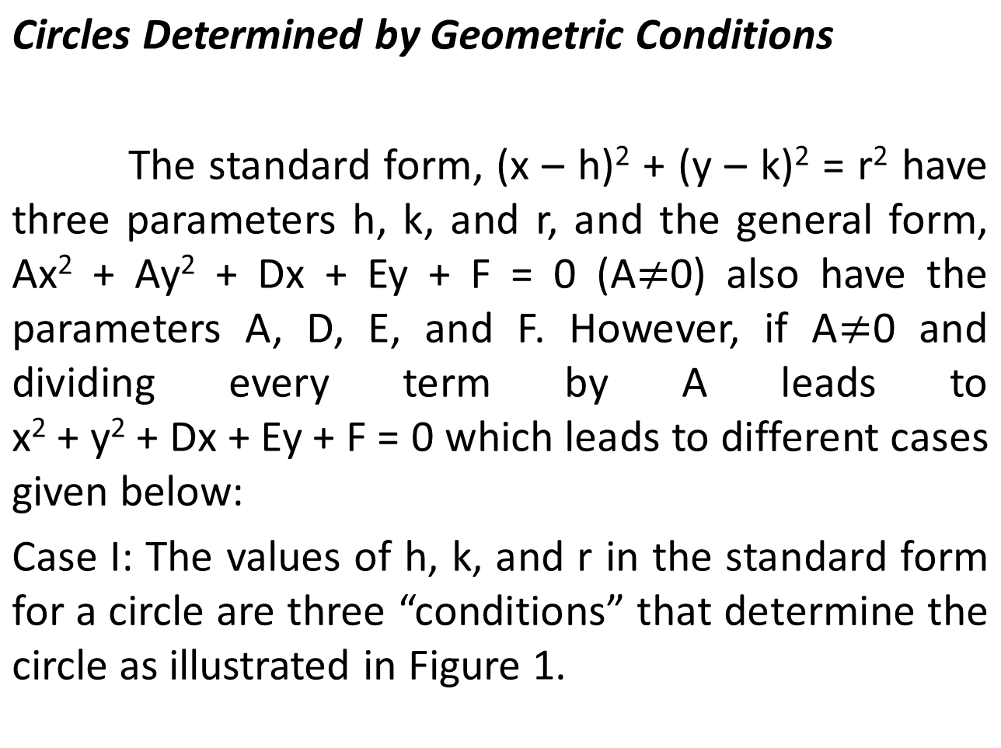

Slide 13
Case II: Three noncollinear points determine a circle as shown in Figure 2. The three points are the three conditions in this case, knowing them gives three conditions in D, E, and F in the general form of a circle. Note that one point (two coordinates) on a circle is a single “condition”, while each coordinate of the center is a condition. More generally, knowing that the center is on the given line can be counted on as a “condition” to determine a circle; knowing h and k is equivalent to knowing that the center is on the lines x = h and y = k.

Slide 14
Case III: The equation of a tangent line, the point of tangency, and another point on the circle as shown in the Figure 3. The center is on the perpendicular to the tangent at the point of tangency. It is also on the perpendicular bisector of the segment joining any two points of the circle. These two lines determine the center of the circle; the radius is now easily found.
Case IV: Tangent line and a pair of points on a circle determine two circles as shown in the Figure 4.

Slide 15
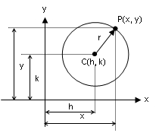
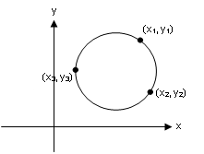
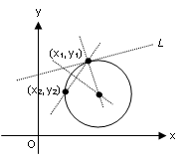
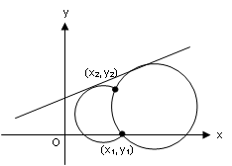
Figure 1
Figure 2
Figure 3
Figure 4

Slide 16
Examples:
If the center of the circle is at C(3, 2) and the radius is 4 units, find the equation of the circle
Find the equation of the circle with center (-1, 7) and tangent to the line 3x – 4y + 6 = 0.
Find the equation of the circle if it is tangent to the line x + y = 2 at point (4 -2) and the center is at the x-axis.
Find the equation of the circle if the circle is tangent to the line 4x – 3y + 12=0 at (-3, 0) and also tangent to the line 3x + 4y –16 = 0 at (4, 1).

Slide 17
Reduce to standard form and draw the circle whose equation is 4x² + 4y² – 4x – 8y – 31 = 0.
Find the equation of the circle having (8, 1) and (4, -3) as ends of a diameter.
Find the equation of the circle which passes through the points (1, -2), (5, 4) and (10, 5).
A triangle has its sides on the lines x + 2y – 5 = 0, 2x – y – 10 = 0 and 2x + y + 2 = 0. Find the equation of the circle inscribed in the triangle.
Determine the equation of the circle circumscribing the triangle determined by the lines x + y = 8, 2x + y = 14 and 3x + y = 22.

Slide 18
A triangle has its sides on the lines x + 2y – 5 = 0, 2x – y – 10 = 0 and 2x + y + 2 = 0. Find the equation of the circle inscribed in the triangle.
Determine the equation of the circle circumscribing the triangle determined by the lines x + y = 8, 2x + y = 14 and 3x + y = 22.
Find the equation of the circle which passes through the points (2, 3) and (-1, 1) and has its center on the line x – 3y – 11 = 0.
Find the points of intersection of the circles x² + y² – 4x – 4y + 4 = 0 and x² + y² + 2x – 4y + 16 = 0. Draw the circles

